Slide 1



Early Prognosis of lung cancer using neural networks
There is a “U CAN” in lung cancer
BY: Lungevity team
Submitted for MTH2175 project
Submitted to: Dr. Samah El-Tantawy

Slide 2


Introduction
Lung cancer affects the lungs and poses significant health concerns.
It occurs when cells in the lungs start growing and multiplying in an uncontrolled manner.
This abnormal cell growth can lead to the formation of tumors, which can be cancerous (malignant) or non-cancerous (benign).
.

Slide 3
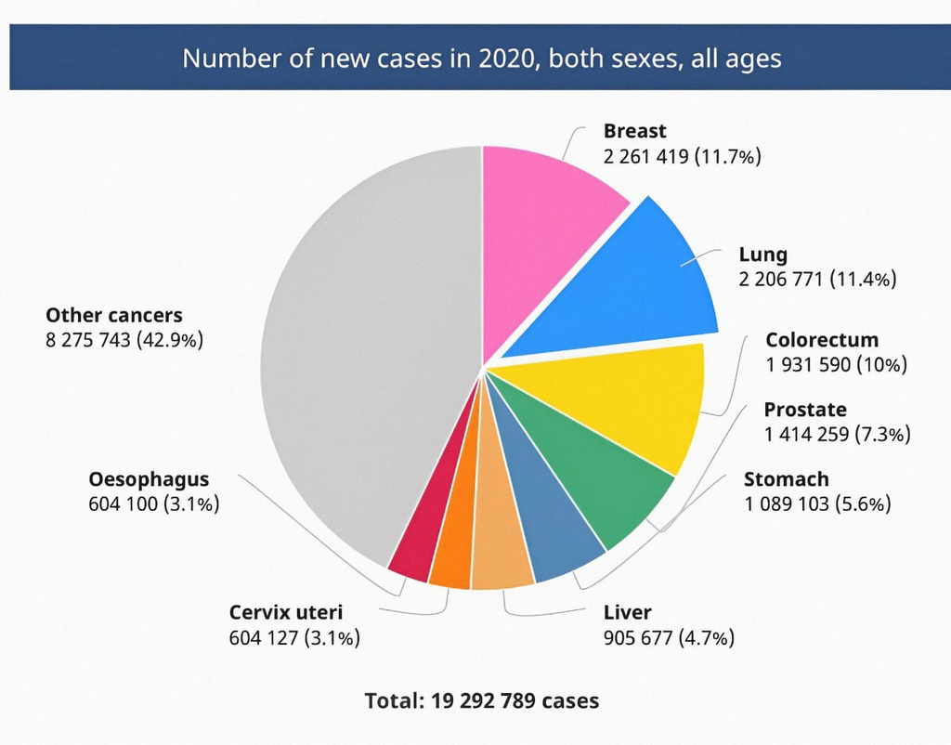
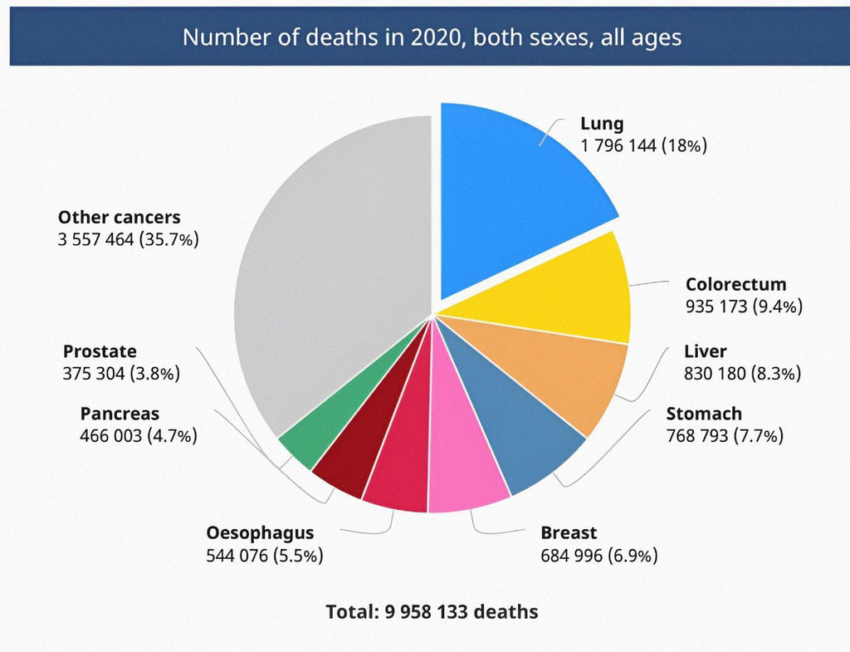
Why Lung Cancer ?
According to the latest WHO data published in 2020 Lung Cancers Deaths in Egypt reached 5,677 or 1.06% of total deaths.
Number of new cancer cases in 2020
Number of deaths in 2020

Slide 4

The challenges faced by the patients in receiving health services:
01.
02.
03.
Late-stage Diagnosis
Delay in starting the treatment process.
Limited Screening Programs.

Slide 5
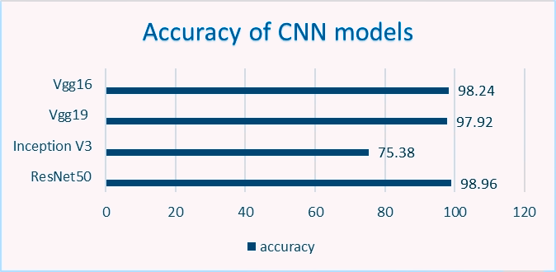
Literature Review
Imaging Techniques for diagnosis of lung cancer:
X-rays.
CT Scans.
Accuracy of CNN models
Lung Cancer Prediction Using Deep Learning:
Neural Network Models:
VGG16.
VGG19.
ResNet 50.
Inception V3.

Slide 6
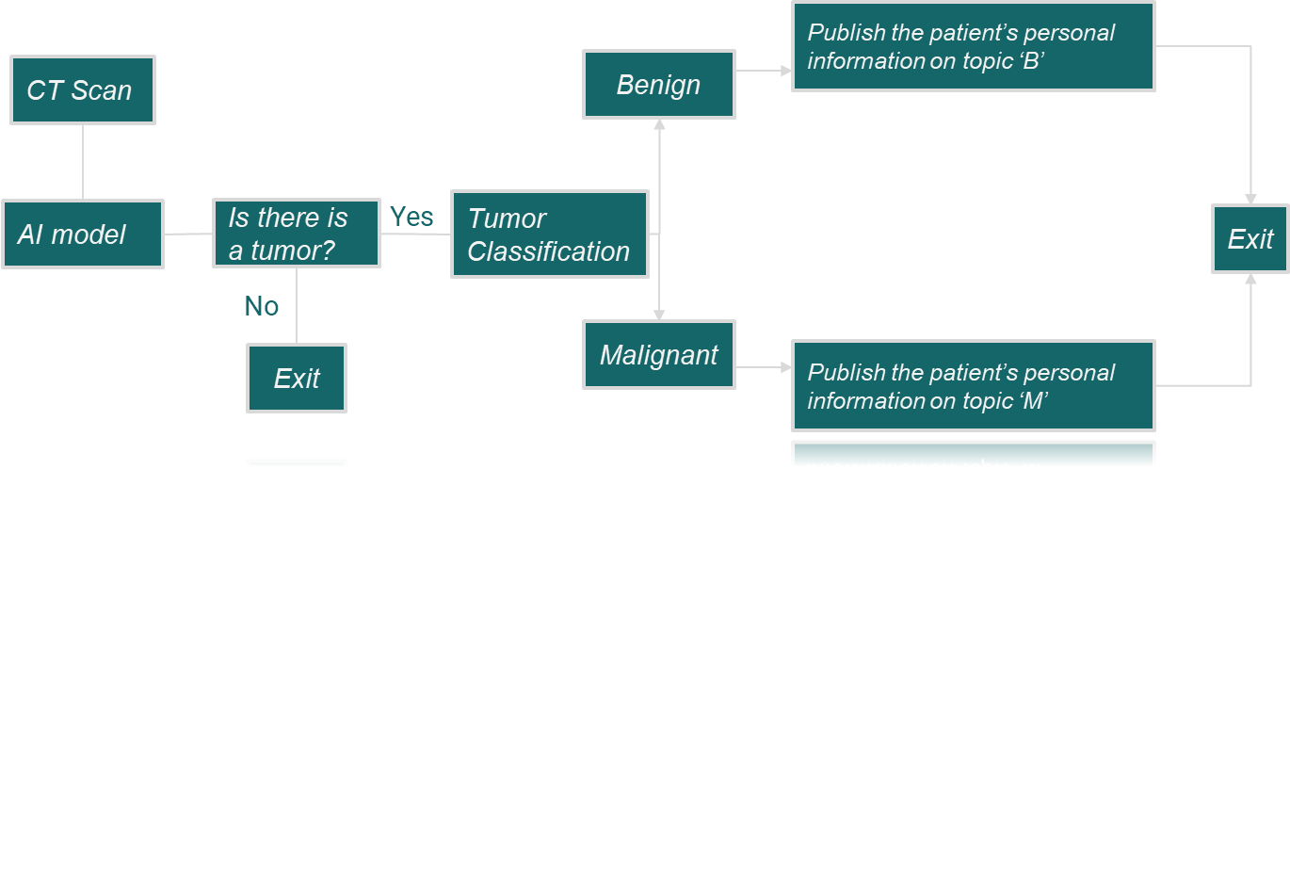
Pathway To Registry

Slide 7
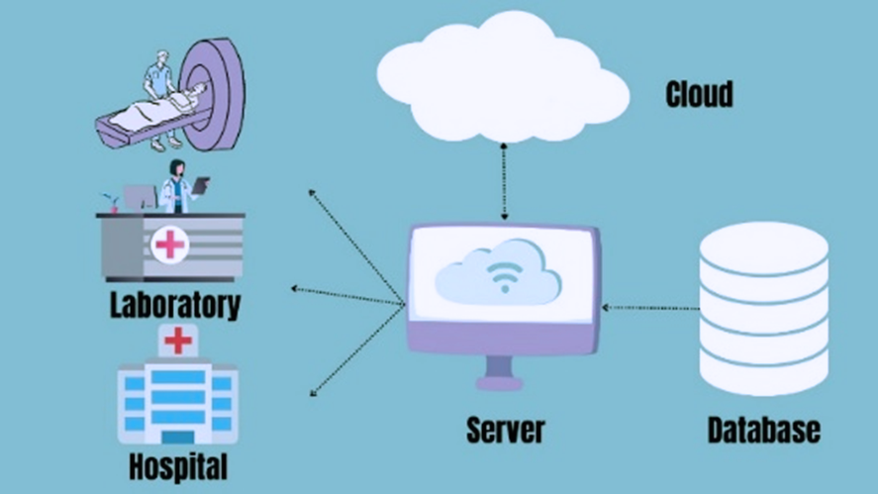
IoT
Database:
personal and contact information of the patient besides its prognosis.
Server:
MQTT broker:TCP/IP protocol.
Relevant authorities:
our model is the publisher and the specialized hospitals are the subscribers

Slide 8


Methodology
Image Preprocessing
Model Construction

Slide 9
Image preprocessing
Image Transformation
Image Resizing
1.
2.
Images to Arrays
Dataset Splitting
3.
4.

Slide 10
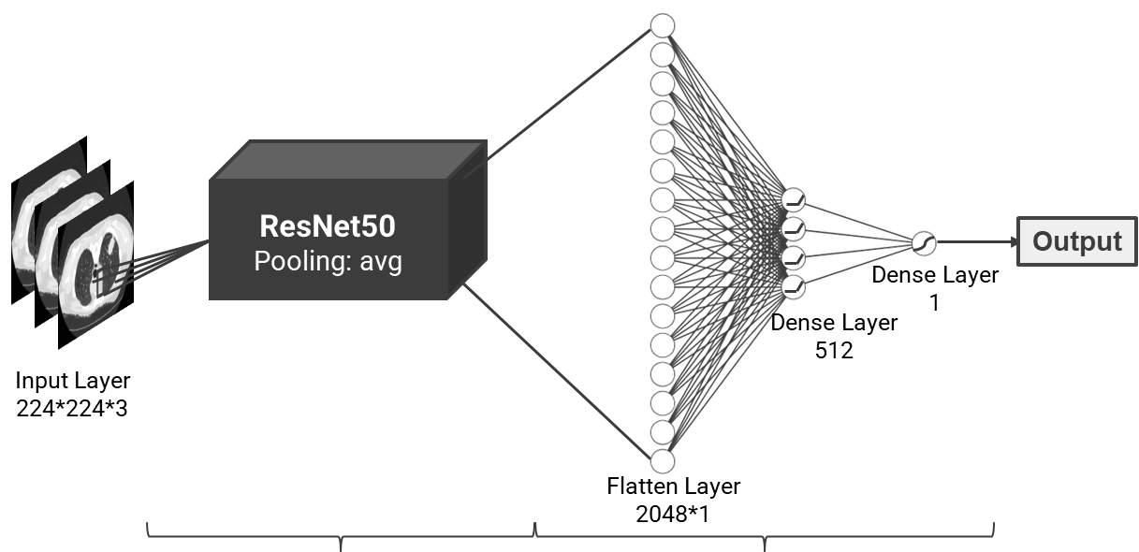
Model Construction
Feature Extraction
Classification

Slide 11


Results & Analysis
Evaluation our Model for Lung Cancer Diagnosis we used Two Datasets:
Dataset 1
364 CT scan images
collected from an Iranian hospital
Dataset 2
1097 CT scan images
collected from two specialist hospitals in Iraq

Slide 12

Results & Analysis
To evaluate the performance of our ResNet50 model, we will take specific criteria into account:
Evaluation criteria:
accuracy
Precision
Sensitivity or recall
Misdiagnosis rate
F1 score

Slide 13
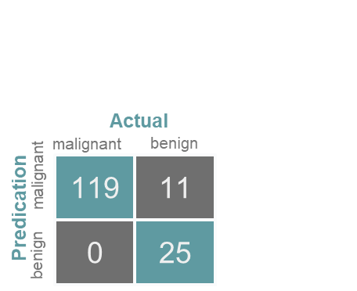
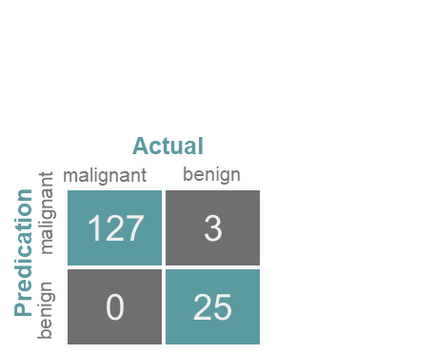
Results & Analysis
We conducted our testing using two distinct configurations concerning the number of epochs which represent how many times the model passes through the entire dataset:
malignant and benign classification
1.Epochs = 10
2.Epochs = 50

Slide 14
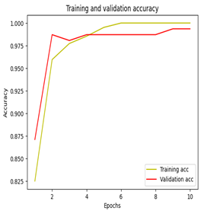
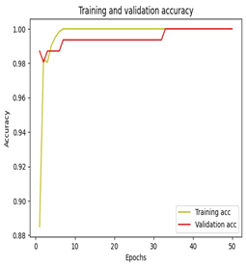
Results & Analysis
we can observe that as the number of epochs increases , both the validation and training accuracy increases .
1.Epochs = 10
2.Epochs = 50

Slide 15

Conclusion
Our study presents a novel approach for lung cancer diagnosis using the ResNet-50 architecture.
We confirmed higher accuracy with more training epochs. Our model effectively detects whether tumors are malignant or benign.
Adding the part of loT, we established a network connecting patients with specialized hospitals to speed-up the registration process.

Slide 16


Future work:
Evaluate the adaptability of our ResNet-50 model across diverse datasets.
Employ a one-level multi-class classification approach.
Enable Palestinian cancer patients to access our IoT platform and publish their info on the server to get notified about empty places.

Slide 17

ANY
QUESTIONS

Slide 18
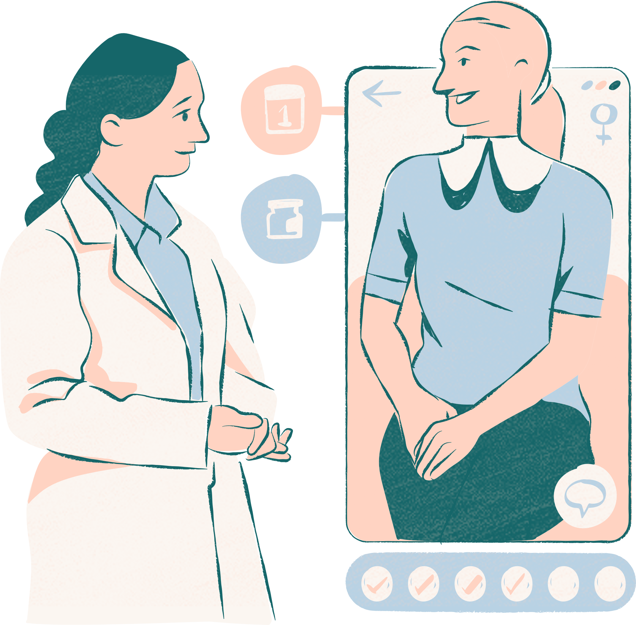
Thank
you!

